Slide 1
Machine Learning Process
Week 3

Slide 2
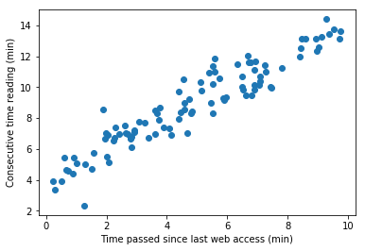
Recall
Did implementing linear regression help your understanding?
Let us take a step back

Slide 3
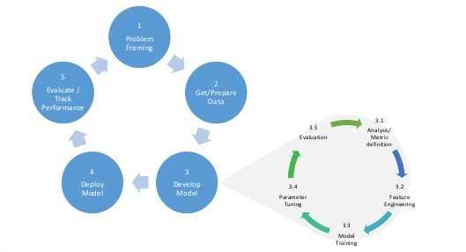
Machine Learning Process
Image courtesy of Microsoft

Slide 4
Model Selection/Development
Linear Regression
What type of other models there can be?
Polynomial models -> polynomial regression

Slide 5

Polynomial Modelling
Recall linear regression
$y=θ_{0}+θ_{1}x$ , $y=θ_{0}+θ_{1}x+θ_{2}x_{2}+…+θ_{p}x_{p}$
Quadratic model
$$y=θ_{0}+θ_{1}x_{}+θ_{2}x_{}^{2}$$
Polynomial model
$$y=θ_{0}+θ_{1}x_{}+θ_{2}x_{}^{2}+θ_{3}x^{3}+…+θ_{p}x^{p}$$

Slide 6

Polynomial Regression
Compare
$y=θ_{0}+θ_{1}x_{1}+θ_{2}x_{2}+…+θ_{p}x_{p}$ (Linear)
$$y=θ_{0}+θ_{1}x_{}+θ_{2}x_{}^{2}+θ_{3}x^{3}+…+θ_{p}x^{p}$$
Same solution as linear regression!!
Just need change of variables
$$θ={\left(X^{T}X\right)}^{−1}X^{T}y$$

Slide 7

Multiple Polynomial Regression
Consider
$$y=θ_{0}+θ_{1} x_{1}+θ_{2}x_{2}+θ_{3}x_{1}x_{2}$$
Still solve using multiple linear regression
Feature Scaling

Slide 8
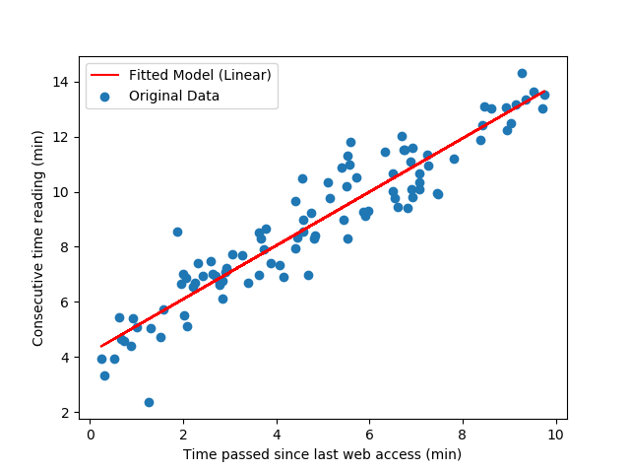
Ammar’s Reading Problem Re-visited
Recall

Slide 9
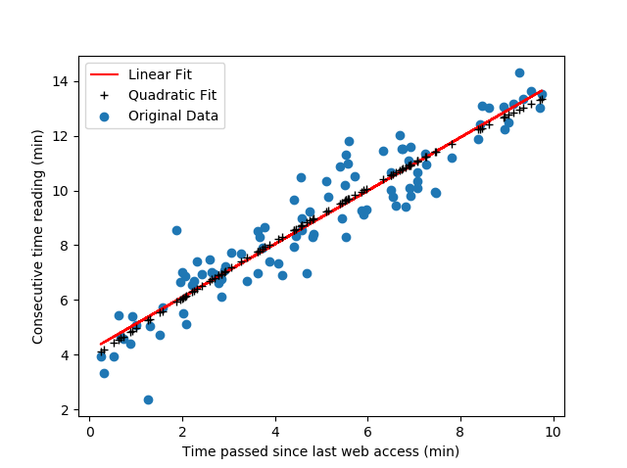
Quadratic Fit
Linear MSE = 0.8
Quadratic MSE = 0.78

Slide 10
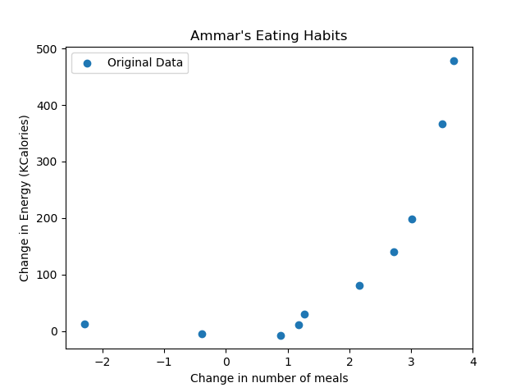
Ammar’s Eating Problem
Typically eat 6 meals, 3000kCal
Tracked my eating habits
Linear is not a good fit

Slide 11
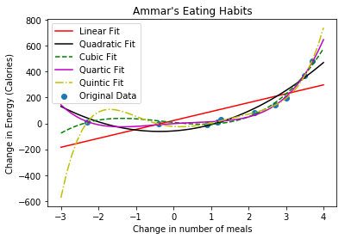
Polynomial Fitting
Errors
Linear = 11073.77
Quadratic = 1995.91
Cubic = 428.43
Quartic = 121.70
Quintic = 12.71
Should choose quintic model
Not necessarily!!

Slide 12
Recap
What did we do today?
What did you learn?
What can you do now that you could not before?
Remember your post-class activities

